Slide 1
Transocean Deepwater Horizon
50 miles SE of Venice, LA

Slide 2
Deepwater Horizon

Slide 3
A Little Background
The DEEPWATER HORIZON was drilling at MC 252 #1 in 4,992’ WD at BP’s MACONDO prospect. We understand they had been fighting lost circulation at 18260’.
MACONDO is a 3 way fault trap amplitude play 4 blocks Northeast of MC292 Gemini E. Prospect partners are: "BP 65%, Anadarko 25%, MOEX Offshore 2007 LLC 10% .

Slide 4
What the NEWS outlets are reporting….
Explosion and fire occurred roughly at 10:00 pm on the night of 20 April 2010
126 personnel were on board
As of 0700 hrs this morning,
115 personnel accounted for
8 injuries……3 critical
11 missing

Slide 5
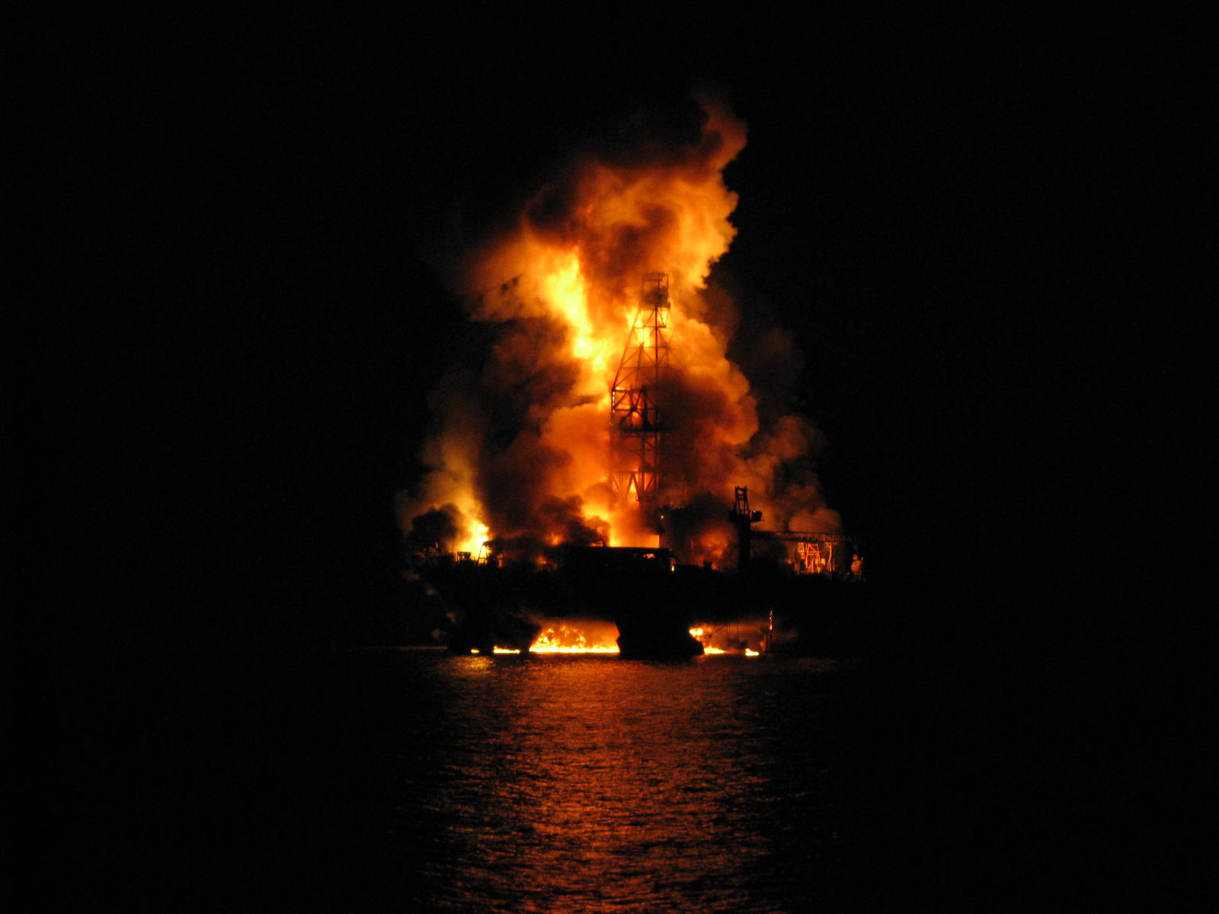

Slide 6
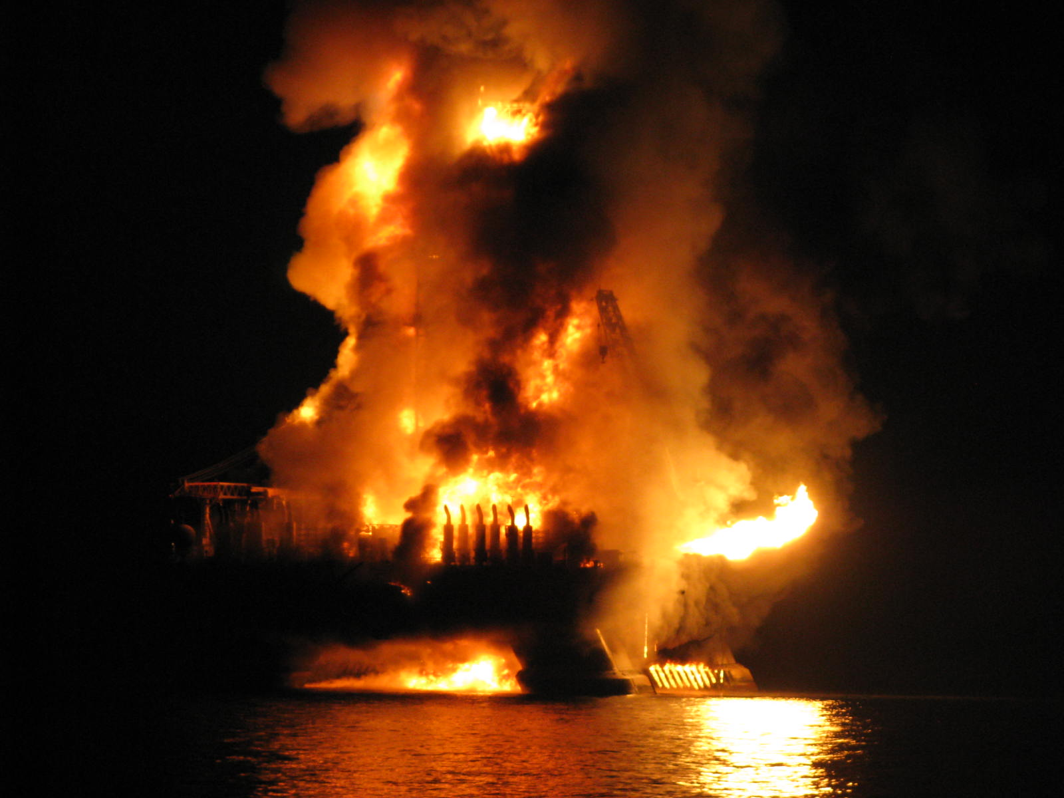

Slide 7
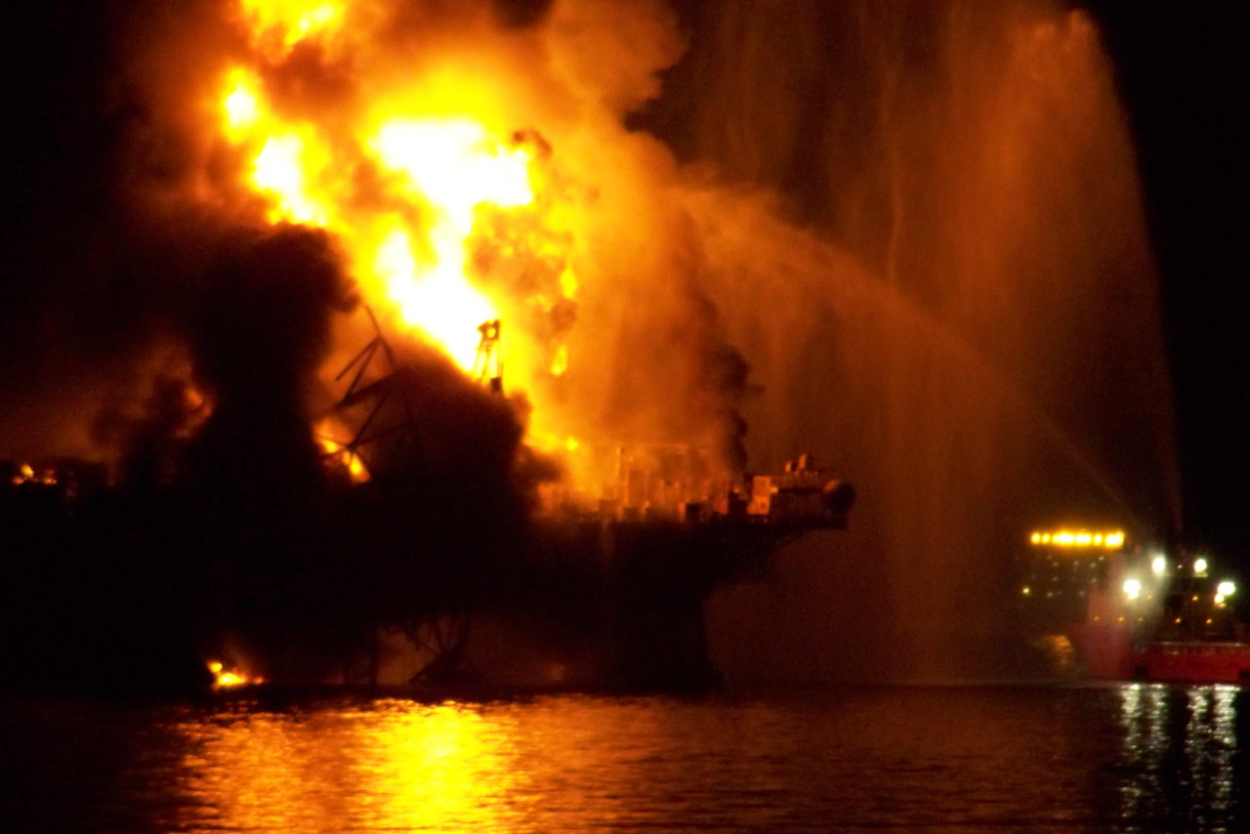

Slide 8
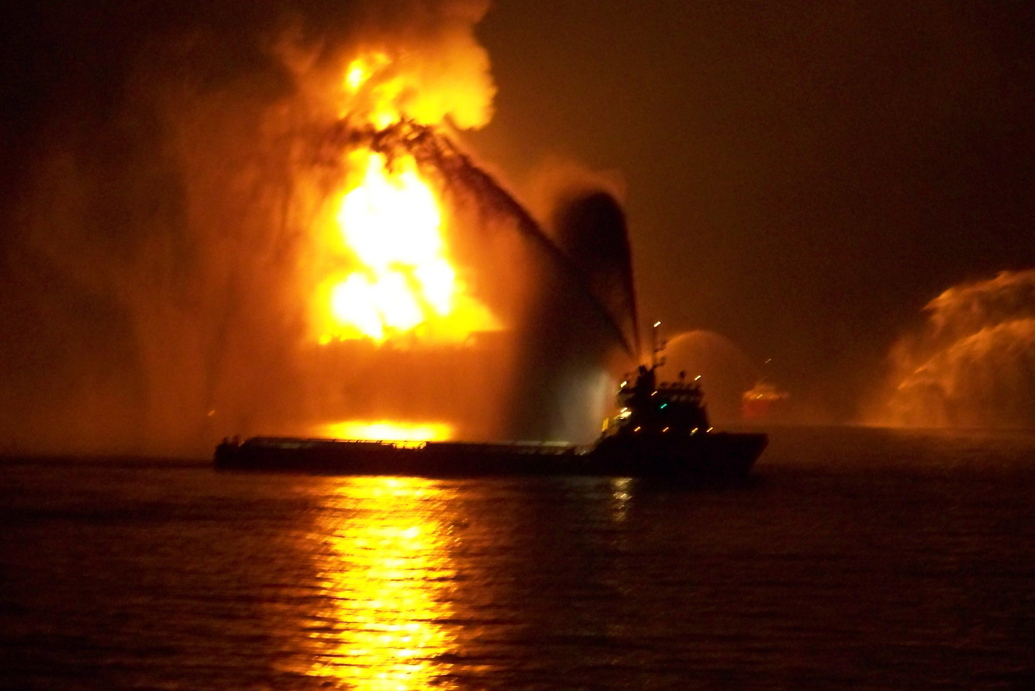

Slide 9
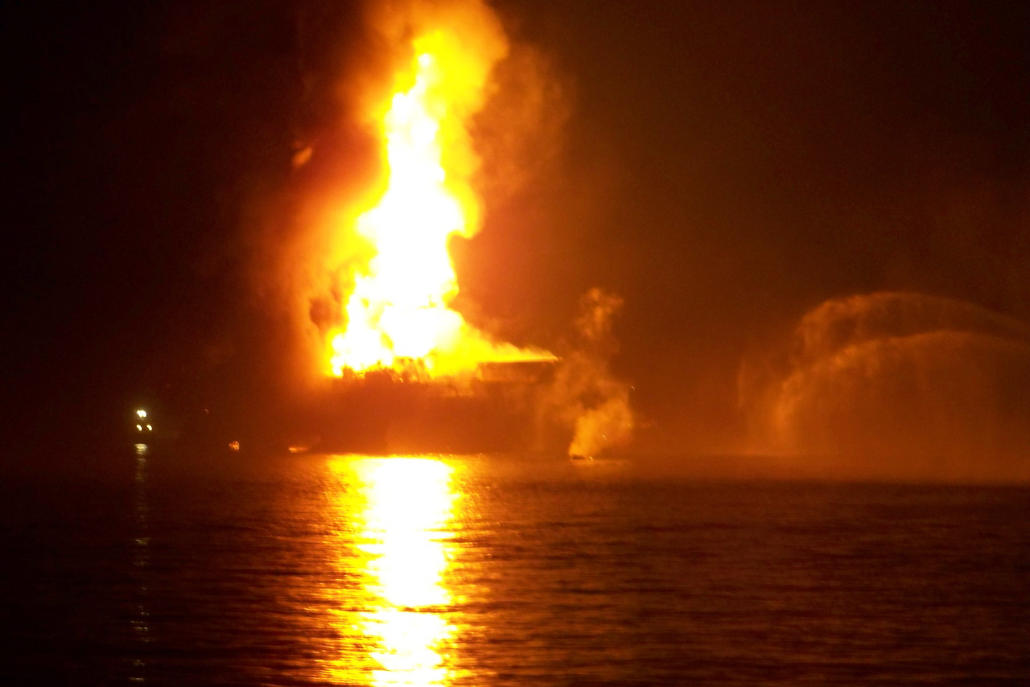

Slide 10
What we Don’t Know
The cause of the explosion and fire

Slide 11
What we DO know……
This is why we have muster drills….practice each time like your life depends on it
This is why we have “persons on board” lists….it may be YOU that we are searching for (or not)
This is why we ask for emergency phone numbers when you arrive…..imagine if delays occurred if notifications to love ones on your well being were delayed

Slide 12
What we DO know……
This is why we have Well Control training (and drills)…. apply your training to protect people, assets, and the environment….drill like it is the real thing
This is why we have procedures, SOP’s, POA’s, etc…….follow these processes or use SWA and/or MOC if they cannot be followed

Slide 13
What we DO know……
This is why we have equipment and personnel always monitoring pit levels and flow show indicators……ensure equipment is maintained, functioning, alarms ON, and people watching, understanding, and communicating

Slide 14
What we DO know……
This is why we have deadman systems on our rigs in the event all power is lost…..always need a way to shut-in well
This is why we have shear rams…….when tubulars are across the BOP that cannot be sheared, we need to minimize the time that the non-shearable material is across the BOP stack
And the list goes on and on

Slide 15
In Closing……
All tragedies affect human beings and companies……
Somebody’s loved one has been injured
Reputations are only as good as yesterday
Regulations are typically written to address past mistakes

Slide 16
In Closing…….
It is not a RIGHT to work offshore….
We have been granted PERMISSION to explore and produce hydrocarbons.
Consistent DEMONSTRATION of SAFE operations help ensure our PERMISSION to work offshore.

